Slide 1

Team Achievers
Final Project

Slide 2
PROJECT TITLE
PORTFOLIO SITE

Slide 3

AGENDA
Aim of our project is to develop and define the purpose and audience for website. Research and gather inspiration for design and layout. Test the website for functionality and usability.

Slide 4

PROBLEM STATEMENT
Introduction and advertisements are very important for any of the business the proposed solution is having portfolio site that will help business or company to display the information about employee and also contact information.

Slide 5

PROJECT OVERVIEW
It is a collection of works or achievements by individual.
It includes variety of content such as images, videos, text and can be designed to both visually appealing and easy to navigate.
It can be great tool for promoting oneself and finding new opportunities in one’s field.

Slide 6

WHO ARE THE END USERS?
The end users of portfolio website are typically individuals or business who want to showcase their work or products.
It include designers, artist, photographers, writers and other professionals.
Potential clients, employers or collaborators would be the main users of portfolio site.

Slide 7

YOUR SOLUTION AND ITS VALUE PROPOSITION
It provides a solution for individuals to showcase their products or work in an easily accessible and appealing manner
The value of proposition of portfolio site is that it allows users to effectively promote their skills and accomplishments to potential client, collaborators increasing the chances of securing new opportunities.

Slide 8

THE WOW IN YOUR SOLUTION
It consist of different colors and layout.
There is also feature to download particular CV
It could be of personalized dashboard for portfolio owner who can see CV and other skills
It is very fast and reliable

Slide 9
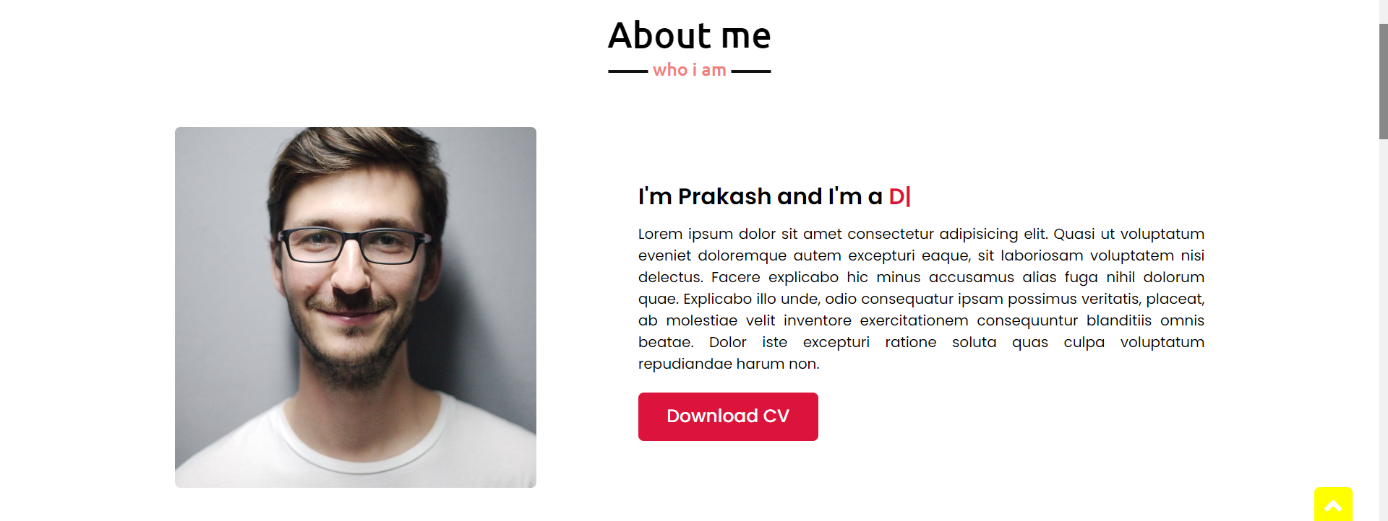
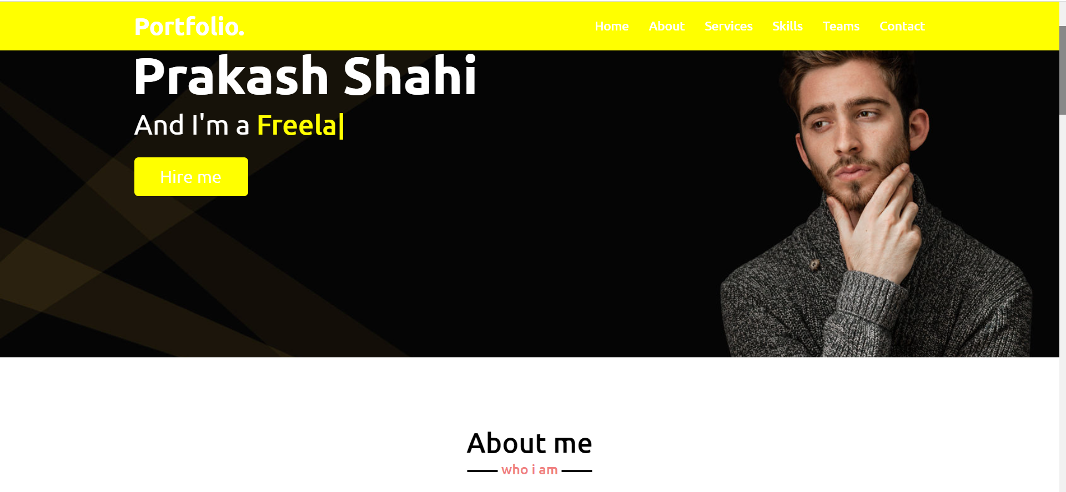
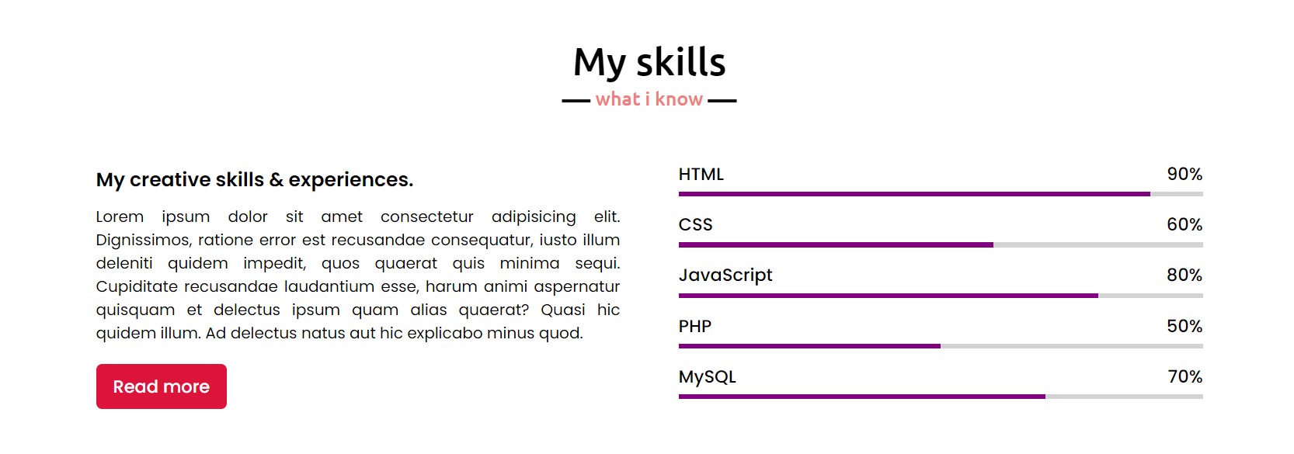
MODELLING

Slide 10
RESULTS
However typical result may include a visually appealing and easy to navigate website that showcases the portfolio creators works , skills and experiences in clear and professional manner.
Additionally it should be easy to access the information and have an easy way to navigate the site.

Slide 11
MEET OUR TEAM
Shashank Rai
B.E Computer Engineering
Thakur College Of Engineering & Technology
Mumbai, India
.
.

